Slide 1
Environmental and Social Impacts on Rural and Northern Health
Community Reflections on Addressing Environmental Challenges in Two First Nations Tuesday September 22nd, 2015
Assess, Redress, Re-assess: Addressing Disparities in Respiratory Health Among First Nations People

Slide 2
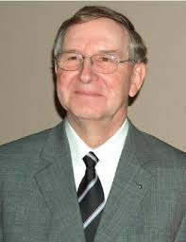
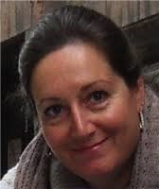
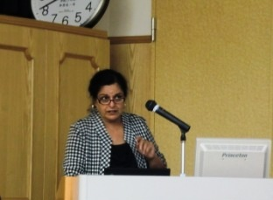
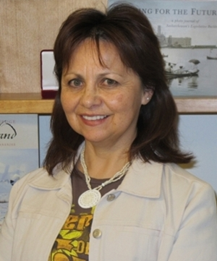
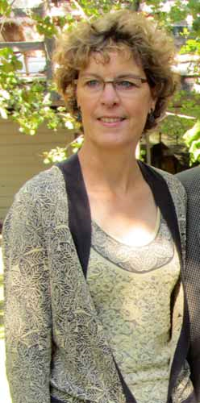
Jo-Ann Episkenew, Chandima Karunanayake, Donna Rennie, Jenny Gardipy, Laura McCallum
Dr. Punam Pahwa
Assistant Professor Community Health and Epidemiology and Canadian Centre for Health and Safety in Agriculture
Dr. James Dosman
Canadian Centre for Health and Safety in Agriculture
Dr. Sylvia Abonyi
Department of Community Health and Epidemiology , Canada Research Chair in Aboriginal Health
Dr. Bonita Beatty
Assistant Professor , Department of Native Studies , University of Saskatchewan
Dr. Linda Larcombe
Assistant Professor, Department of Internal of Medicine, University of Manitoba

Slide 3
Research proposal Title: Cree Tipi Teachings: An Intervention Approach to Addressing Housing and Lung Health in Two First Nations Communities
Research Statement
What do two First Nations communities living in differing environmental contexts ( Woodlands Cree and Willow Cree ) see as strategies (home, housing, community) that are amenable to intervention in First Nations people living on reserves in rural Saskatchewan?
Or
What do two rural First Nations communities living in southern and northern Saskatchewan( Woodlands Cree and Willow Cree ) see as approaches to improving health in themselves, their homes, and community?

Slide 4
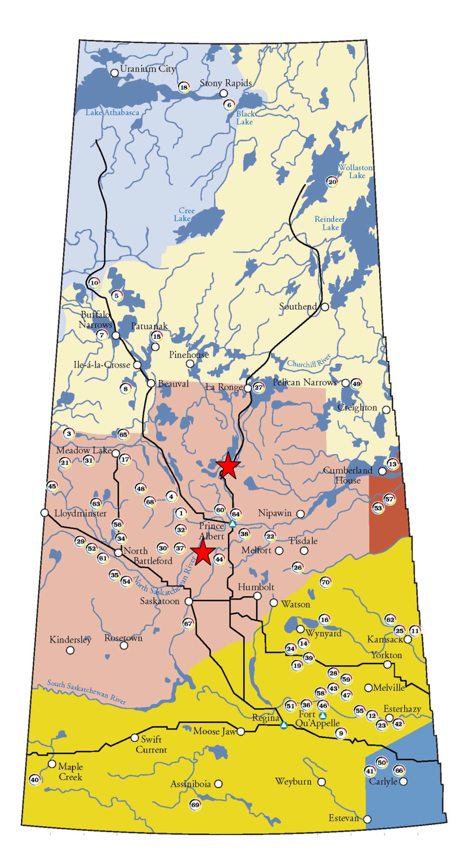
Participating First Nations Communities and Treaty Boundaries
Both Treaty Six members
Both Cree communities are part of the 1.4
million people who self-identified
as an Aboriginal person in Canada
Both are part of the 15.6 percent of the
Saskatchewan population comprised of
Aboriginal peoples (157,740 individuals ).
Of those, both are part of the 65.4%
(103,205) who reported a First Nations
identity .
Aboriginal Demographics from the 2011 National Household Survey.
Retrieved from https://www.aadnc-aandc.gc.ca/eng/1370438978311/1370439050610

Slide 5
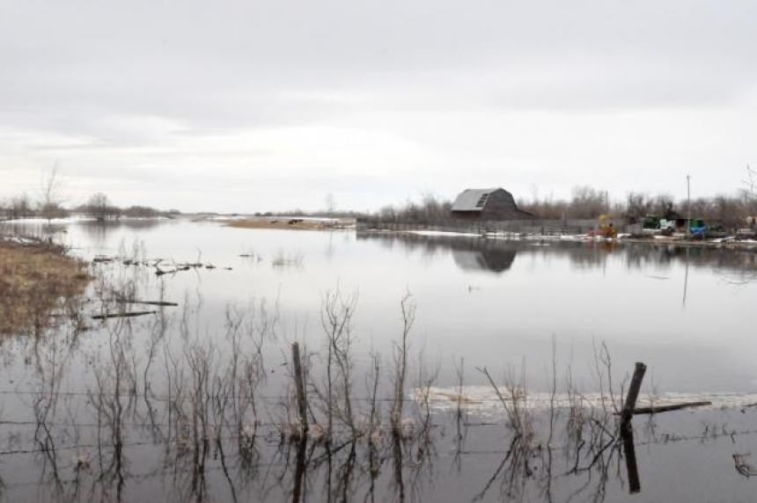
What do two First Nations communities living in differing environmental contexts ( Woodlands Cree and Willow Cree ) see as strategies (home, housing, community) that are amenable to intervention in First Nations people living on reserves in rural Saskatchewan?
Willow Cree
Farming environment
Population on reserve
1325
Ecosystem prone to
flooding
http://fnp-ppn.aandc-aadnc.gc.ca/fnp/Main/Search/FNPopulation.aspx?BAND_NUMBER=369&lang=eng
By Sean Leslie // May 3, 2013
Notes:
http://fnp-ppn.aandc-aadnc.gc.ca/fnp/Main/Search/FNPopulation.aspx?BAND_NUMBER=369&lang=eng

Slide 6
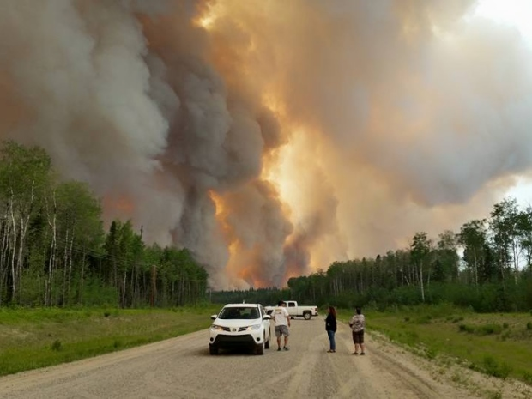
What do two First Nations communities living in differing environmental contexts ( Woodlands Cree and Willow Cree ) see as strategies (home, housing, community) that are amenable to intervention in First Nations people living on reserves in rural Saskatchewan?
Woodland Cree
Boreal forest/lake
environment
Reserve Population:
1395
Ecosystem subject to
fire
http://fnp-ppn.aandc-aadnc.gc.ca/fnp/Main/Search/FNPopulation.aspx?BAND_NUMBER=354&lang=eng
(thatconradguy/Facebook) July, 2015

Slide 7
Background
Objective : ‘to find out how the places in which we live can be linked with poor lung health and can be solved in some ways by First Nations people living on reserves in rural Saskatchewan.’
Objective Two: “to test the hypothesis that personal, social and physical environments are associated with adverse respiratory outcomes that are amenable to intervention in First Nations people living on reserves in Saskatchewan.”

Slide 8
Background
Information shared by community members will help to solve some of the issues or problems involved and will help in planning for health service delivery.
‘The answers are within us’

Slide 9
Background
Ideas and actions that promote health and prevent lung disease in First Nations populations will guide plans to improve disease outcomes, including public education programs and health services programs.

Slide 10
Background
What we find out will empower First Nations members to make changes in their communities, as well as assist in shaping provincial and national programs and priorities.

Slide 11
PIs- Dr. James Dosman, Dr. Sylvia Abonyi, Dr. Punam Pahwa and Dr. Jo-Ann Episkenew Method
Honor protocols of the communities
Elders guide all parts of project including previous ethics application, focus group question development, examination of data and approval of final reports.
Eleven focus groups took place in the two research communities to find out member’s views of housing conditions and health.
Recordings written and copied
Transcripts ready for exploration of themes and recommendations within Community member’s reflections

Slide 12
Method
First findings:
Challenges and solutions related to housing, smoking control, body weight and other areas not previously considered in the proposal for the study.
Participants meet the challenges through their personal and community experiences
Cree Tipi Teachings interesting basis by which to understand the information.

Slide 13
What do two First Nations communities living in differing environmental contexts ( Woodlands Cree and Willow Cree ) see as strategies (home, housing, community) that are amenable to intervention in First Nations people living on reserves in rural Saskatchewan?
Aboriginal peoples have higher :
Death and illness rates
Smoking rates
Rates of asthma
Chronic obstructive pulmonary disease (long lasting lung disease eg emphysema)
Sleep apnea (not breathing while asleep)
Heart disease
Stroke
Obesity
Type 2 diabetes.

Slide 14
What do two First Nations communities living in differing environmental contexts ( Woodlands Cree and Willow Cree ) see as strategies (home, housing, community) that are amenable to intervention in First Nations people living on reserves in rural Saskatchewan?
Higher risks are linked to causes such as :
Low family income
Low education
Over-crowded and/or inadequate housing (houses with dampness and/or mold)
Impact of colonization on Aboriginal peoples is a risk factor for poorer health status (e.g. poor education, housing, health services)

Slide 15
Focus groups 2013/14
Information collected from eleven focus groups (70 people)
Individual and community values evident in meeting challenges
Discussions of principal findings of the study :
Findings on laminated posters to stimulate discussion
Participant’s identity confidential
Community categorized by letter and number
Standard focus group methodology utilized with informal discussion.
Participants informed sessions audio recorded.
Discussions center on participants’ experience with housing conditions, and what participants can do to improve housing conditions ,and personal/family health

Slide 16
Principle Findings: Our Life Style Choices
Community A
Out of 144 houses surveyed
People smoke in more than 1/2 the houses (83 )
About 337 people surveyed , over ¾ smoked (260)
Community B
Out of 206 houses surveyed
People smoke in almost 1/2 the houses (102 )
About 358 people surveyed , over ¾ smoked (275)

Slide 17
Principle Findings: Our Health
Community A
Out of 337 people surveyed:
About 1/3 have sinus problems (108)
About 1/3 have bronchitis (107)
About ¼ have had pneumonia (84)
About 1/5 have asthma (64)
Community B
Out of 358 people surveyed:
About 1/4 have sinus problems (92)
About 1/4 have bronchitis (78)
About 1/3 have had pneumonia (97)
About 1/5 have asthma (59)

Slide 18
Discussion Guide for Facilitators
What is my reaction to the information presented?
What do I think I could do to make our housing healthier?
What do I think our family could do to make our house healthier?
What could I do to make myself healthier?
What could we do to make our children healthier?
How could we obtain healthier food?
What about exercise?
What about our sleeping habits?

Slide 19
What is my reaction to the information presented?
CHALLENGES
SOLUTIONS
Lack of awareness : stats
Alarm
Shock
Surprise
Disturbing
Apathy
Indifference
Concern (second hand smoke ,especially children)
Share stats
Family meetings toward healthier home
Quit smoking for financial and other reasons
Smoke outside ( Green Light Project)

Slide 20
What do I think I could do to make our housing healthier?
CHALLENGES
Air Quality
SOLUTIONS
Poor ventilation
Humidity
Buy fans or maintain exhaust fans
Dehumidifier
Air purifier

Slide 21
What do I think I could do to make our housing healthier?
CHALLENGES
Mold
SOLUTIONS
Moldy basements
Sewer back ups
Bathroom moisture in floorboards/walls
Leaky roofs
* Lots of visitors = more humidity
*One bathroom in over-crowded houses
Dehumidifier
Mop after baths/showers
General maintenance
Check roofs and insulation around doors

Slide 22
What do I think I could do to make our housing healthier?
CHALLENGES
Water issues
SOLUTIONS
Hard water
High chlorine
Rust build up
Contamination
Buy water coolers
Buy water softeners
Boil water advisory

Slide 23
What do I think I could do to make our housing healthier?
CHALLENGES
Water systems
SOLUTIONS
Need to know that cisterns are cleaned annually
Expensive filter systems
Old copper tubing plugged
Quick sand damage to old wells
Well condemned
Dig new wells
Clean cisterns annually
Buy small filter systems
Check and replace copper tubing
Maintain house repairs

Slide 24
What do I think I could do to make our housing healthier?
SOLUTIONS
CHALLENGES
‘If current positions are maintained by both government and First Nation leaders…limited new houses will be built, the backlog will continue to grow and maintenance will become more of an issue… some treaty First Nations to try to solve this dilemma themselves. Some groups are looking at bank financing and others are looking at putting specific by-laws in place that will address their ability to provide housing for their members. Government must support this effort and allow the First Nation administrations flexibility, time and resources to develop their own solutions (Brant,2000, p.36)
No flood insurance
Expensive for band
No choice in residence
More people create more wear and tear on a house
Extended families not considered in design of houses
Treaty right to housing not honored

Slide 25
What do I think I could do to make our housing healthier?
CHALLENGES
Dust
SOLUTIONS
Dust
Poor ventilation
Dust allergies
Dusty reserve
Open windows and dust gets in
Dusty carpets
Daily sweeping, dusting
Improve ventilation
Keep windows sealed
Replace carpets w linoleum
Summer, close windows to keep out dust, move to cool damp basement

Slide 26
What do I think I could do to make our housing healthier?
CHALLENGES- Hoarders
SOLUTIONS
Keeping too much stuff
Fire hazard
Mouse droppings
‘If it’s dirty anything can grow there, or whatever, if you’re smelling mold or whatever
Vandalism
Awareness of links to health issues
Get rid of items and set mouse traps
Log homes

Slide 27
What could I do to make myself healthier?
SOLUTIONS
CHALLENGES
Allergies to smoke
Smoke in public places, bingos, wakes, meetings
Smoke in Band offices cause headaches
Housebound
‘I can walk by a person and tell if he had smoke on him. Either way it hits me. And for that reason, I hardly go to the bingos when they have them, here or at the senior’s lodge.’
Ban smoking in public
Walk in evenings w friends from work and children
Garden
Eat more fruits and vegetables
Cross-fit (intense work –out )at school gym every evening, open to all
Don’t watch TV
Leaders model healthy behavior and respect for constituents’ health
Walk in house, stretch, swing arms
MEND Program-Mind, Exercise, Nutrition, Do it!

Slide 28
What could we do to make our children healthier?
SOLUTIONS
CHALLENGES
Frustration : dependency
Health risks by waiting for band repairs
Everyone’s waiting for the band office; the band office will come and fix it. Well I was talking to a woman today who said she was still waiting and waiting and waiting on the band to resolve an issue for her .She finally said, you know what? I can’t wait anymore. I put my grandchildren and their health at risk by leaving the home the way it is.
Family members take initiative to repair houses
So, she’s taking it upon herself, and that’s what we need. We need more action from people to say, you know what? I’m going to take on responsibility. I was given a home, I’m going to look after it, I’m going to take care of it, I’m going to provide the best damned environment. It’s clean, it’s safe, it’s healthy for my children.

Slide 29
What could we do to make our children healthier?
SOLUTIONS
CHALLENGES
Parenting skills
Sedentary lifestyle
Staying up until 2
Sleeping all day
X-box
Lazy phones
Role modelling by being a healthier person yourself
Join parent support groups
Set structure through family meetings
Model reading to create awareness
More exercise for healthier sleep
Fresh air daily

Slide 30
How could we obtain healthier food ?
SOLUTIONS
CHALLENGES
Lack of fresh fruit and veggies at local store
Healthy food expensive
Community gardens not successful
Weeding hard work
Hunting hard work, legislated, expensive equipment
Community garden
Home gardens
Berry picking
Hunt deer, moose, elk
Fish
Teach young people how to hunt and prepare wild food
Buy wild meat
Buy organic beef
Hunt ducks
Guide hunters
Partner w Hutterites

Slide 31
How could we obtain healthier food ?
SOLUTIONS
CHALLENGES
Too much pop
Easier to go to Walmart
Junk food diet
Processed food, boxed potatoes
Chemicals on farmers market vegetables
Too much fast food
Deep fried foods
All lead to diabetes, emotional eating ,
obesity , sleep apnea
less fast food
healthier choices in restaurants
no pop
less sugar
more home cooking
eat lots of fish and chicken
Learn about new and healthier foods at CrossFit
Safe food handling
Nutrition classes
Home cooking
Balanced diet
Notes:
Diabetes
Emotional eating
Obesity
Sleep apnea

Slide 32
What about exercise?
SOLUTIONS
CHALLENGES
Couch potato syndrome
Drive everywhere
Too tired
Cross country skiing
Jogging
Walking
Sliding
Notes:
Diabetes
Emotional eating
Obesity
Sleep apnea

Slide 33
What about our sleeping habits?
SOLUTIONS
CHALLENGES
Less than 6 hours sleep
distracted by phone and iPad
go to bed late and get up early
visit late every night
sleep apnea
mentally tired
sleep deprivation
Sleeping pills
Back and joint pain
Boozing
Heartburn
Stress/anxiety
10 15 minutes leisure walk
watch TV half an hour and go to bed
don’t visit so late
shut off phone
shower
get up to breathe
play w children after work
lost weight, lower blood sugar
CrossFit
Set goals to lose weight and get in shape
Exercise
Quit alcohol
Tums
Mental Health Therapist /workshops
Notes:
Diabetes
Emotional eating
Obesity
Sleep apnea

Slide 34
What do two First Nations communities living in differing environmental contexts ( Woodlands Cree and Willow Cree ) see as strategies (home, housing, community) that are amenable to intervention in First Nations people living on reserves in rural Saskatchewan?
Cree tipi teachings - intervention approach
Views of traditional /modern dwellings
Tipi represents kinship patterns and values of its peoples.
Values inside focus group discussions
Shape how participants solve health and housing issues
Promote/maintain cultural preservation.

Slide 35
Cree tipi teachings - intervention approach
Obedience Kinship
Cleanliness
Thankfulness
Sharing
Strength
Good Child Rearing
Respect
Humility
Happiness
Love
Faith
Hope

Slide 36
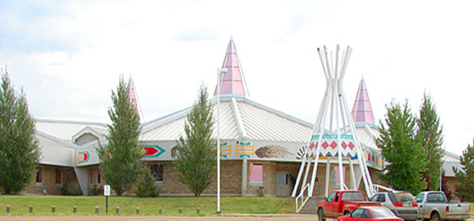
Values in focus group discussions
Hope:
Guidance
We must maintain hope for ourselves, our family and our community, both materially and spiritually
‘I only smoke when I drink and I'm cutting down my drinking so that's a another step for me. So slowing down my smoking and drinking. And being more open to my spirituality, you know, and letting go of all the bad stuff and what the good stuff come in is leading to a healthier life for me.’

Slide 37
Values implicit in focus group discussions
Good Child Rearing:
Guidance
Children are gifts from the Creator. They are given to us on loan to care for and to be responsible for their well being. They represent the continuity of our circle of life.
Role modelling by being a healthier person yourself
Join parent support groups
Set structure through family meetings
Model reading to create awareness
More exercise for healthier sleep
Fresh air daily

Slide 38
Values implicit in focus group discussions
Sharing
Guidance
We learn to be a productive part of our family by helping and sharing
‘I think keeping kids physically active because obesity is a big factor in our reserve here… so I started soccer three times a week and it's free for three it to eight-year-olds, and they don't need soccer equipment because it's expensive. All sports out here, they cost money to get your kids and, and then you have to get the equipment and everything... it's a big problem especially if you're only getting $250 a month. ..and I provide everything else , the nets and the balls … Just to show them a healthy lifestyle and I think eating too. Like obesity is a big factor in our reserve and I just give more healthy snacks.’’

Slide 39
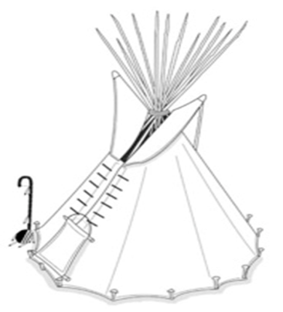
Values implicit in focus group discussions
Ultimate Protection
Guidance
The ultimate responsibility is to achieve and protect a healthy balanced and caring mind, body and spirit as individuals, family and community of nations.
‘ I honestly believe … we can be happier if we’re doing the right things. Like when I hear people tell me, I’m doing this now (sports). And you can see a glow in their eyes…if they can feel good about themselves that makes me feel good because I know we are influencing, especially that little CrossFit group we have in our community. You know, more people are starting to get involved.’

Slide 40
ACKNOWLEDGMENTS This study was funded by a grant from the Canadian Institutes of Health Research (CIHR) “Assess, Redress, Re-assess: Addressing Disparities in Respiratory Health among First Nations People”, CIHR MOP-246983-ABH-CCAA-11829. We are grateful for the contributions of community members who donated their time to participate in the focus groups.
Questions?
Is it possible to get stats on TB ?
What are the stats for the most common lung issues in these communities? How do they compare to other First Nations? To other Canadians?
What are the final stats for smokers compared to other First Nations? To other Canadians?
What are the stats for Lung Cancer among First Nations?

Slide 41
Questions?
How many people have babies/children living in the home, when they’re smoking?
How many know the ideal humidity rates of houses? How many people know the humidity of their houses?
What is the main mode of cooking?
How many houses need dehumidifiers, vents and fans?
Can band houses be insured for floods?
How much of an issue is dust in reserve houses and health?
How many people smoke in vehicles w passengers?
What types of programs are offered in the communities that are targeted at environmental health? Youth activities?

Slide 42
Questions?
Where can Bands apply for grants and funds for programs to address the challenges found in this study?
What kinds of housing/health issues do CHRs face and how they deal with them?
What are the types of rodent diseases that people should know about?
Is it common practice for Health Centres and Schools to meet regarding attendance/health issues?
Are there links to residential schooling and impacts on parenting ? What was the response to the Truth and reconciliation meetings in the communities?
Can berry picking be revived as a form of socialization?
Can schools teach gardening? Are there summer programs that can continue a garden program initiated by schools?

