Slide 1
A Study of the Respiratory Health of First Nations Children Living in Rural Saskatchewan: Methodological Approaches and Comparisons with the Saskatchewan Rural Health Study Children’s Component
Rennie, D.C., Karunanayake, C., Pahwa, P., Hagel, L., Seeseequasis, J., Naytowhow, A., Russell, B., Warkentin, S., Dosman, J.and the First Nations Lung Health and Saskatchewan Rural Health Study Groups

Slide 2
Purpose
To compare response rates in the baseline surveys of two prospective cohort studies of respiratory health in rural school children in Saskatchewan.

Slide 3
Saskatchewan Rural Health Study (SRHS) and First Nations Lung Health (FNLH) Study
Background:
Canadian Institutes of Health Research 2010-2015
MOP-187209-POP-CCAA-11829
Canadian Institutes of Health Research 2012-2017
MOP-246983-ABH-CCAA-11829

Slide 4
Conceptual Framework*
Covariates:¹
Demographic
Co-morbidity
Health Status
Individual Factors:^{1,3}
Family history
Lifestyle/behavioral
Occupational exposures
Health Outcomes:^{1,2,}
Chronic bronchitis
COPD
Asthma
Lung function
Contextual Factors:^{1,3,4}
Socioeconomic
Housing conditions
Access to Health Services
Assessment Methods: 1. Survey questionnaire; 2. Clinical assessment;
3. Environmental assessments; 4. Health care utilization records.
*Based on Population Health Framework
Diagram courtesy of Dr. Will Pickett.

Slide 5
Prospective Cohort Design
SRHS Baseline Surveys | FNLH Baseline Surveys
Four study quadrants | Two reserves
Household and Individual surveys Adults 18 yrs+
School Survey Children 6-17 yrs
Clinical Studies (Adults and Children) Spirometry Skin testing for allergies Blood pressure, height and weight
Exposure to Grain Dust Study | Environmental Assessments in Homes
Saskatchewan Health Databases
Follow-up Study

Slide 6
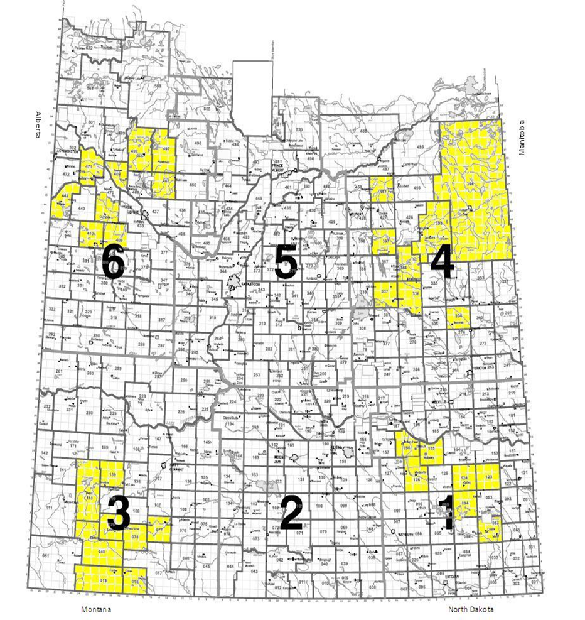
SRHS Baseline Surveys
Quadrant | Schools
North West | 12
North East | 10
South West | 7
South East | 10
Total | 39
FNLHS Baseline Surveys
First Nations | Schools
Reserve 1 | 3
Reserve 2 | 1

Slide 7
Methodology
 | SRHS | FNLHS
Number of Schools | 39 of 43 | 4 of 4
Study Package | Letter to parent/guardian Questionnaire Information letter Consent (2 copies) parents Assent forms (2 copies) child | Letter to parent/guardian Questionnaire Information letter Consent/assent forms (modified) emancipated (E) ≥16 yrs
Participants ages questionnaire clinical | 6-17 6-14 | 6-17 6-17
Respondent | Parents and guardians | Parents, guardians and E ≥16 yrs
Incentive/Reminders | None/ ~ 2 weeks | $5.00 gift certificate/ ~ 2 weeks
Role of Nurses | Collect questionnaires from schools Organize and perform clinical assessments | Distribute questionnaires. Collect questionnaires from schools Organize and perform clinical assessments

Slide 8
SRHS Baseline School Survey
39 schools – grades 1 -12
5667 children
Total Responses
2757 children
Non-Respondents
2910 children
Participants
2383 children (42%)
Refusals
374 children
Clinical Measurements
16 schools – grades 1 to 8
1800 children
Participants
795 children (44.1%)
Clinical Participants
626 children (34.7%)

Slide 9
First Nations Baseline School Survey
4 schools
603 children
Total Responses
363 children
Non-Respondents
240 children
Participants
351 children (58.2%)
Refusals
12 children
Clinical Participants
297 children (49.2%)

Slide 10
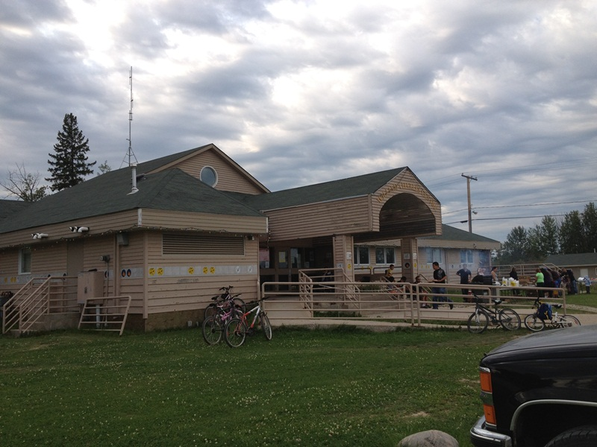
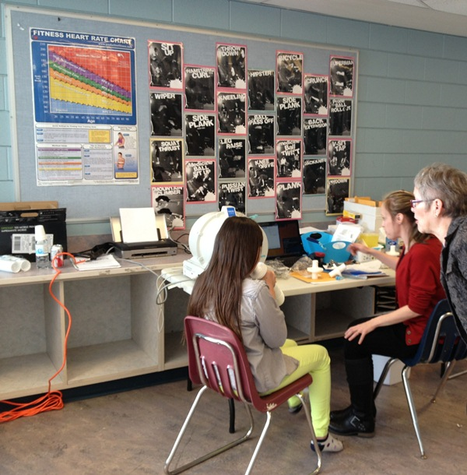

Slide 11
Comparison of SRHS 2010 Children
and FNLHS 2013 Children
Sex | SRHS 2010 Children (6-18 years) n (%) | FNLHS 2013 Children (6-17 years) n (%)
Male | 1173 (49.2) | 165 (47.0)
Female | 1210 (50.8) | 186 (53.0)
Age, in years | SRHS 2010 Children (6-18 years) n (%) | FNLHS 2013 Children (6-17 years) n (%)
6-10 years | 1014 (42.8) | 175 (49.9)
11-14 years | 858 (36.2) | 126 (35.9)
15-18 years | 499 (21.0) | 50 (14.2)

Slide 12
Participation Rates:
 | SRHS | FNLHS
Questionnaire based Survey | 2383/5667 42.0% | 351/603 58.2%
Clinical Measurements | 626/1800 34.8% | 297/603 49.2%

Slide 13
Conclusions:
Factors that contributed to increased participation rates in the FNLHS were:
Researchers in continuous community contact
Provision of incentives for participation
Simplification of the consent/assent process.
Maintaining research staff in widely dispersed rural communities is expensive and challenging.

Slide 14
Thanks to……..
The children, parents and teachers in all 43 schools that participated in our studies.
The research assistants and nurses that travelled the province to conduct the field research, 10 in all.

Slide 15
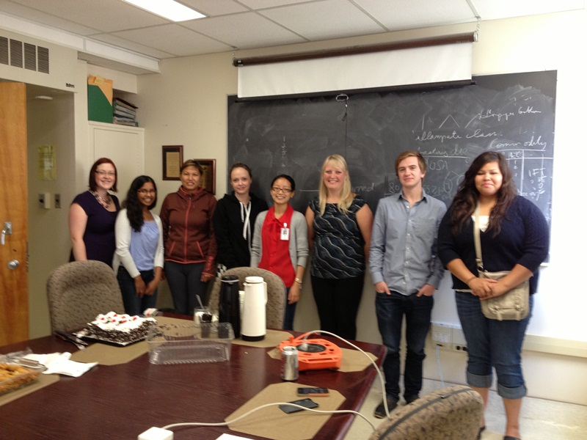
Clinical Research Assistants - FNLHS

Slide 16
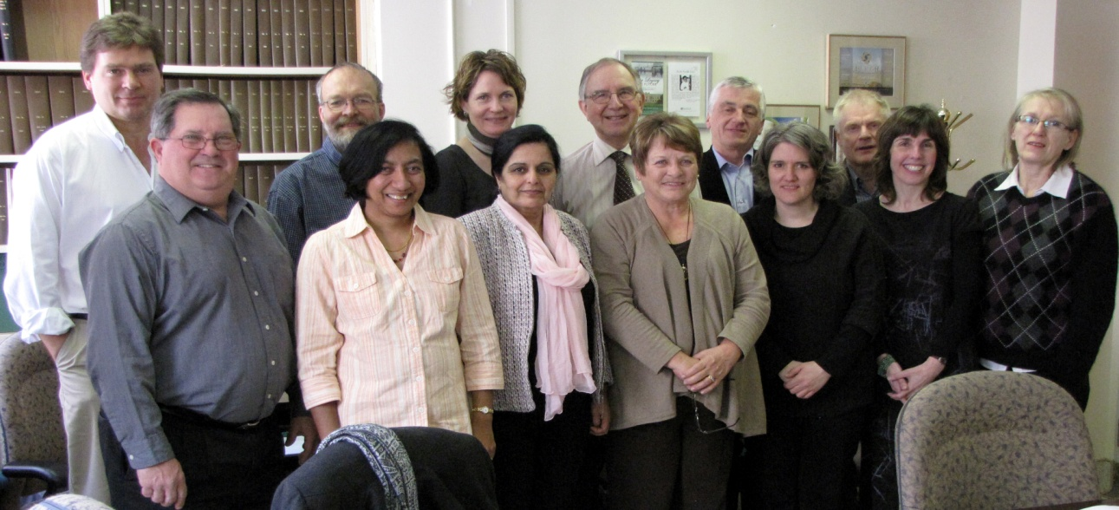
SRHS Study Group

Slide 17
Questions?

