Slide 1
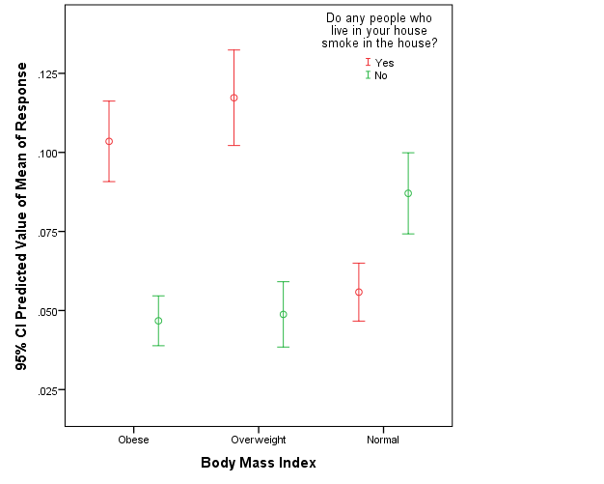
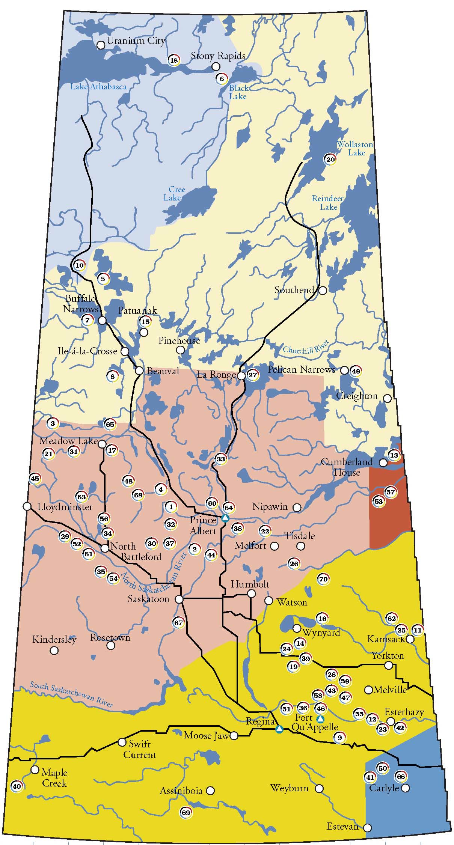
Prevalence of Chronic Bronchitis in First Nations People Punam Pahwa,^{1, 2,*} Chandima P. Karunanayake,¹ Donna Rennie, ¹ Kathleen McMullin,¹ Josh Lawson,¹ Jeremy Seeseequasis,# Arnold Naytowhow,# Akwasi Owusu-Kyem,¹ Louise Hagel,¹ Sylvia Abonyi,^{2,*} Jo-Ann Episkenew,^{3,*} James A. Dosman^{1,*} and the First Nations Lung Health Project Research Team ¹ Canadian Centre for Health and Safety in Agriculture, ² Department of Community Health and Epidemiology, University of Saskatchewan, Saskatoon, Saskatchewan, Canada ³Indigenous Peoples’ Health Research Centre, University of Regina, Regina, Saskatchewan, Canada. *Co-Principle Investigators of the First Nations Lung Health Project # Community Partners of the First Nations Lung Health Project
BACKGROUND
In 2006 the population of Aboriginals in Saskatchewan was 141,890 persons, comprised of First Nations (91,400), Metis (48,115) and Inuit (215), in total representing 15% of the population. In Saskatchewan, an estimated 52% of First Nations people live on reserves.
Smoking rates are high among on-reserve First Nations adults (58.8% vs. 24.2% among all Canadians) and contribute to both excess mortality and adverse respiratory outcomes.
Poor housing conditions (dampness and mold) contribute to bronchitis and asthma.
There is limited knowledge related to the prevalence and determinants of chronic bronchitis (CB) among Canadian First Nations people.
Statistical Analysis
Logistic regression models to predict relationship between binary outcome presence/absence of chronic bronchitis and individual (cigarette smoke, obesity) and contextual factors (socio-economic status, housing conditions).
Robust variance estimation using generalized estimating equations, accounting for the two-stage sampling procedure was used in the analysis.
Table 2. Odds Ratios (95% confidence intervals) based on multivariate logistic regression* for associations with chronic bronchitis
Variable | Adjusted OR (95% CI)
Household smoking Yes No | 0.36 (0.11, 1.16) 1.00
Mildew odor or musty smell in home Yes No | 2.02 (1.04, 3.92) 1.00
Age, in years 18-25 26-35 36-50 >50 | 1.00 1.07 (0.36, 3.13) 4.94 (1.99, 12.21) 6.27 (2.66, 14.75)
Sex Male Female | 1.00 1.61 (0.84, 3.09)
Smoking Status Never smoker Ex-smoker Current smoker | 1.00 1.19 (0.34, 4.12) 0.82 (0.27, 2.45)
Body Mass Index (kg/m²) Normal (0-<25) Overweight (25-30) Obese (>30) | 1.00 0.19 (0.06, 0.61) 0.16 (0.04, 0.55)
In the past 12 months difficulties getting access to the routine or on-going care Yes No | 1.84 (0.92, 3.69) 1.00
Interactions
Household smoking X Body Mass Index Household smoking(Yes) X Obese Household smoking(Yes) X Overweight Household smoking(Yes) X Normal | 2.10 (0.64, 6.87) 2.87 (1.02, 8.06) 0.36 (0.11, 1.16)
*Adjusted for repeated measure on households
RESULTS
Total n=406 households (70% response rate) and total n=874 adult individuals (55.7% response rate) were surveyed.
This analysis was based on n=746 participants who were responded to the question “Has a doctor ever said you had chronic bronchitis?”
The mean age was 34.78 ±14.37 years and 17.4% of study population were older than 50 years.
There were 51.3% females; 28.7% were overweight; 35.4% were obese.
RESEARCH OBJECTIVES
The aim of the current study was to determine the prevalence of chronic bronchitis and associated risk factors among First Nations people.
STUDY DESIGN AND METHODOLOGY
The study is being conducted over 5 years (2012-17) in two phases, baseline and longitudinal. Currently, we have completed collecting baseline survey data for adults and children from the two First Nations reserves (Reserve 1 & Reserve 2).
The baseline adult survey consists of a questionnaire-based evaluation of individual and contextual factors of importance to respiratory health (with special focus on chronic bronchitis, chronic obstructive pulmonary disease, asthma and obstructive sleep apnea).
Clinical lung function and allergy tests are being conducted with the consent of study participants.
TABLE 1. Bi-variable analysis of the association of chronic bronchitis on personal and environmental factors (n=746)
 | Ever Diagnosed with Chronic Bronchitis |  | Unadjusted# Odds Ratio (95% CI)
 | Yes /Total | (%)
Environmental Factors
Household smoking Yes No | 37/405 19/312 | 9.1 6.1 | 1.56 (0.87, 2.79) 1.00
House in need of repairs Yes, major repairs Yes, minor repairs No, only regular maintenance | 23/289 18/198 14/211 | 8.0 9.1 6.6 | 1.22 (0.61, 2.45) 1.39 (0.65, 2.98) 1.00
During past 12 months, water or dampness Yes No | 33/433 22/244 | 7.6 9.0 | 0.83 (0.47, 1.48) 1.00
House damages caused by dampness Yes No | 33/374 18/299 | 8.8 6.0 | 1.51 (0.83, 2.72) 1.00
Mildew odor or musty smell in home Yes No | 38/369 15/300 | 10.3 5.0 | 2.18 (1.18, 4.03) 1.00
Signs of mold or mildew in home Yes No | 33/336 18/306 | 9.8 5.9 | 1.75 (0.95, 3.23) 1.00
Wood store or wood to heat house Yes No | 1/27 54/684 | 3.7 7.9 | 0.46 (0.06, 3.62) 1.00
House heating system has a filter Yes No | 50/560 3/67 | 8.9 4.5 | 2.08 (0.65, 6.62) 1.00
Personal Factors
Age, in years 18-25 26-35 36-50 >50 | 8/263 6/182 22/171 21/130 | 3.0 3.3 12.9 16.2 | 1.00 1.06 (0.39, 2.89) 4.65 (2.04, 10.56) 5.99 (2.63, 13.63)
Sex Male Female | 22/363 35/383 | 6.1 9.1 | 1.00 1.56 (0.90, 2.73)
Education < High School ≥ High School | 24/368 33/376 | 6.5 8.8 | 0.72 (0.40, 1.31) 1.00
Body Mass Index (kg/m²) Normal (0-<25) Overweight (25-30) Obese (>30) | 16/250 18/214 19/264 | 6.4 8.4 7.2 | 1.00 1.34 (0.67, 2.67) 1.13 (0.56, 2.28)
Smoking Status Never smoker Ex-smoker Current smoker | 5/71 9/99 43/576 | 7.0 9.1 7.5 | 1.00 1.31 (0.42, 4.13) 1.05 (0.42, 2.62)
In the past 12 months difficulties getting access to the routine or on-going care Yes No | 17/121 38/547 | 14.0 6.9 | 2.20 (1.18, 4.09) 1.00
Within household clustering is accounted for by multi-level univariate# logistic regression; odds ratios that are significantly different from 1.00 (p< 0.05) are in boldface.
Figure 3. Interaction between household smoking and body mass index
CONCLUSIONS
Our results suggest that significant determinants of chronic bronchitis are: increasing age and mildew odor or musty smell in home.
Household smoking modified the relationship between body mass index and chronic bronchitis.
CLINICAL IMPLICATIONS
Modifiable risk factors identified were housing conditions such as mildew odor or musty smell in home and household smoking and obesity in the communities.
Reserve 1
ACKNOWLEDGMENTS
This study was funded by a grant from the Canadian Institutes of Health Research “Assess, Redress, Re-assess: Addressing Disparities in Respiratory Health Among First Nations People”, CIHR MOP-246983-ABH-CCAA-11829. We are grateful for the contributions of all the participants who donated their time to complete and return the survey.
Reserve 2
Figure 1. Participating First Nations Reserves and Treaty Boundaries in Saskatchewan

